Slide 1

BRIGHTLEARN COFFEE SHOP

Slide 2
TABLE OF CONTENT
Coffee Shop Mission & Vision Statements
Overview
Findings
Recommendations
Questions & Answers

Slide 3
VISION:
OUR COMMITMENT TO SUSTAINABILITY REVOLVES AROUND ETHICALLY SOURCING OUR COFFEE BEANS. WE PRIORITISE FAIR AND DIRECT TRADE PROCEDURES TO ENSURE TRANSPARENCY AND RESPONSIBLE SOURCING. OUR ETHICAL COLLABORATIONS EMPOWER FARMERS AND BENEFIT THEIR COMMUNITIES WHILE ENSURING QUALITY AND TRACEABILITY.
MISION:
TO TREAT CUSTOMERS WITH RESPECT LIKE FAMILY, AND THEY WILL BE LOYAL TO OUR BRAND

Slide 4
OVERVIEW
The coffee shop data was collected for 6 months, starting from January to June from 3 store. The objective is to analize the data and see the sales report for different products and use the results to make sound business decisions.
I cleaned the given raw data so that it can be used in my SQL queries. I used excel, databricks,Canva and Miro as my tools for this project. Different queries were created to get time buckets sales period by product category and details, compared the 3 stores for the period of 6 months. After my analysis, I was able to retrieve 6 different reports that will be used to make sound business decisions by our new CEO.
Findings and recommendations are tabled on the slides.

Slide 5
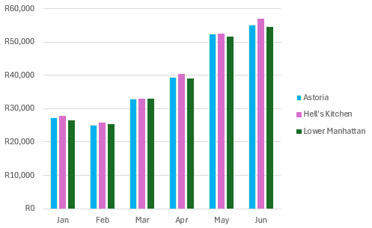
REVENUE GENERATION:STORE LOCATION
INSIGHT :ALL STORE LOCATIONS HAD AN INCREASE IN THE SALE OF COFFEE FROM MARCH TO JUNE, REASON BEING THE CHANGE IN SEASONS AS CLIENTS DRINK MORE COFFEE IN WINTER.

Slide 6
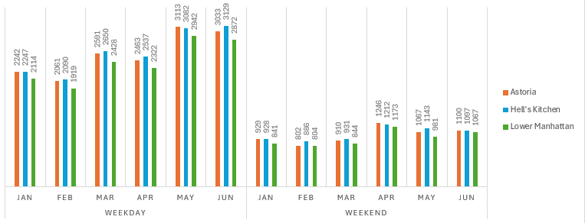
SALES COUNT PER MONTHS
INSIGHT: ALL STORES SOLD MORE COFFEE DURING THE WEEKDAYS AS COMPARED TO WEEKEND.
LOWER MANHATTAN SHOULD PROMOTE THEIR PRODUCTS AS THEY SELL LESS PRODUCTS THROUGH OUT.

Slide 7
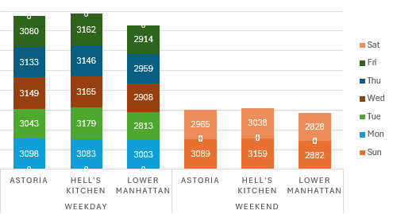
SALES PER DAY OF THE WEEK
INSIGHT: FRIDAYS SOLD MORE COFFEE THAN THE OTHER DAYS OF THE WEEK
ASTORIA &HELL’S KITCHEN SOLD ALMOST THE SAME NUMBER OF PRODUCTS

Slide 8
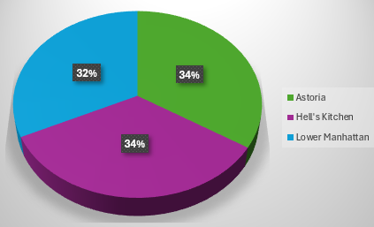
TOTAL PERCENTAGE SALES BY STORE
INSIGHT: LOWER MANHATTAN SOLD THE LEAST NUMBER OF PRODUCTS.
POPULATION AROUND LOWER MANHATTAN NEEDS TO BE LOOKED INTO TO UNDERSTAND THEIR SPENDING PATTERN

Slide 9
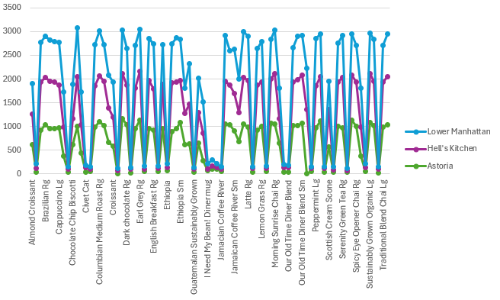
MONTHLY SALES BY PRODUCT CATEGORY
INSIGHT: JAMAICAN COFFEE RIVER AND I NEED MY BEAN DINER MUG ARE THE LEAST SELLING PRODUCT CATEGORY.
PROMOTIONS ARE RECOMMENDED ON JAMAICAN COFFEE RIVER AND I NEED MY BEAN DINER MUG TO INCREASE THEIR SALES

Slide 10
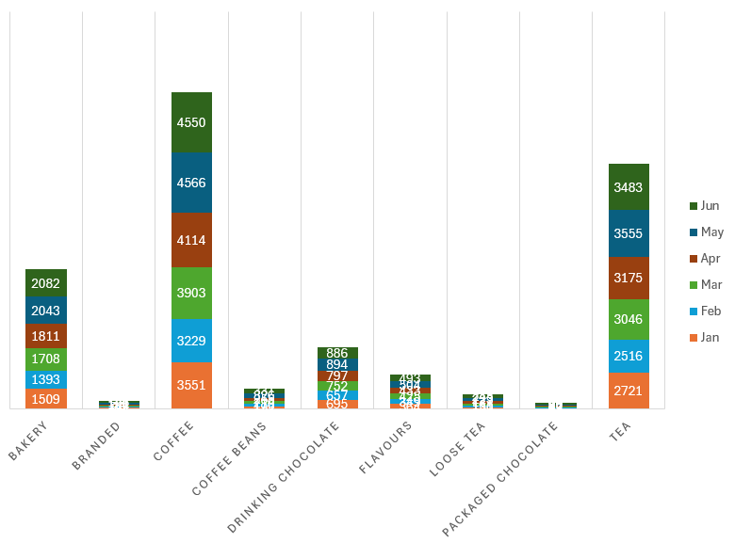
MONTHLY SALES BY PRODUCT DETAIL
INSIGHT:BAKERY, COFFEE AND TEA ARE THE MOST SELLING PRODUCTS.
A REVIEW FOR ALL PRODUCTS AND DECIDE IF THEY NEED TO BE PROMOTED OF FACED OUT

Slide 11
FINDINGS:
All stores had an increase in their sales with June being the highets
Hell’s Kitchen is the highest selling store between the 3 stores
3.Jamaican coffee river &I need my Bean river mug are the least selling product category at all stores
Bakery, Coffee & Tea are the top selling product details at all our stores
All our stores sold more than 30% of their products
RECOMMENDATIONS
To run promotion on weekend to atracts more customer and increase sales in return
Take a decision on Jamaican coffee river & I need my Bean river mug product category, to keep them or discontinue as they are the worst selling category.
To do a research to get a number of people around Low Manhatten to use that info against the sales, to determine if the population count play a role in their low number of sales or if it is the store than need to up theirgame.
Spend a 5% of sales revenue to support the community & they will support us in return

Slide 12
Questions & Answers

